Slide 1
Issues with member variables

Slide 2
Outline
In this lesson, we will:
Observe some issues with our classes
See that any fixes can be corrupted by the user
Introduce the idea of encapsulation
Protecting the data in an object from the user
See that the critical times in an object’s life are:
How it is initialized when it is created
How the user accesses and manipulates the object during its lifetime
How it is cleaned up when it is destroyed

Slide 3
Issues with rational numbers
We looked at a rational number class:
What happens here?
Rational p{};
The ratio 0/0 is not a rational number
But we cannot prevent a user from writing using our class like this
Equivalently, a user may incorrectly or accidentally set the denominator to zero:
p.denom_ = 0;
Under these circumstances, none of the arithmetic operations are properly defined

Slide 4
Ensuring a non-zero denominator
One solution is to prefix every function and operator with a check that any denominators are not zero:
Rational operator+( Rational const &p, Rational const &q ) { assert( (p.denom_ != 0.0) && (q.denom_ != 0.0) ); return Rational{
p.numer_*q.denom_ + q.numer_*p.denom_, p.denom_*q.denom_
};
}
This is going to be expensive: the cost of these checks will slow any system down
Problem: As long as the user has access to the member variables, we are forced to make such checks

Slide 5
Normal forms
Another issue:
These are all the same rational number:
Rational p1{-1, 2};
Rational p2{100, -200};
Rational p3{-47, 94};
Rational p4{99, -198};
Wouldn’t it be great if all of these were stored the same way?
We could require:
The denominator must be positive
The greatest common divisor of the numerator and denominator should be one
These two rules make the representation unique
This is called a normal form

Slide 6
Normal forms
For example, we could do the following:
Rational operator+( Rational const &p, Rational const &q ) { assert( (p.denom_ != 0.0) && (q.denom_ != 0.0) );
int numer{ p.numer_*q.denom_ + q.numer_*p.denom_ };
int denom{ q.denom_*p.denom_ };
int divisor{ gcd( numer, denom ) };
if ( denom < 0 ) {
denom = -denom;
numer = -numer;
}
return Rational{ numer/divisor, denom/divisor };
}
We also require a function
int gcd( int m, int n );

Slide 7
Normal forms
We cannot, however, assume this, as the user may :
bool operator==( Rational const &p, Rational const &q ) { assert( (p.denom_ != 0.0) && (q.denom_ != 0.0) );
return (p.numer_ == q.numer_)
&& (p.denom_ == q.denom_);
}
bool operator==( Rational const &p, Rational const &q ) { assert( (p.denom_ != 0.0) && (q.denom_ != 0.0) );
return (p.numer_*q.denom_ == q.numer_*p.denom_);
}

Slide 8
Normalizing a rational number
Note, if we are always normalizing, we could author the following function:
void normalize( Rational &q ) {
assert( q.denom_ != 0 );
if ( q.denom_ < 0 ) {
q.numer_ = -q.numer_;
q.denom_ = -q.denom_;
}
int divisor{ gcd( q.numer_, q.denom_ ) };
q.numer_ /= divsor;
q.denom_ /= divisor;
}

Slide 9
Normalizing a rational number
We could write these two functions:
Rational operator+( Rational &p, Rational &q ) { normalize( p );
normalize( q );
Rational result{
p.numer_*q.denom_ + q.numer_*p.denom_,
q.denom_*p.denom_
};
normalize( result );
return result;
}
Problem:
We cannot declare p or q to be constant…

Slide 10
Normalizing a rational number
We could write these two functions:
Rational operator==( Rational &p, Rational &q ) { normalize( p );
normalize( q );
return (p.numer_ == q.numer_)
&& (p.denom_ == q.denom_);
}
Again,
we cannot declare p or q to be constant…

Slide 11
Normalizing a rational number
Now, more work is done work checking and normalizing the numerator and denominator than the actual operation
We cannot ever assume the rational arguments are normalized, because the user may change either member variable
If you are the only user of this class, no problem
In industry, however, your class will be used by:
Other employees or groups within the company
Clients and customers
The public in general
Whoever replaces you in your position when you leave or are promoted

Slide 12
Issues with our Array class
Next, let us discuss the Array class:
class Array {
double *array_;
std::size_t capacity_;
};
Here are all the problems:
The user may not even initialize an instance
A wild pointer Array data;
The user may initialize it with default values
A null pointer Array data{};
The user may accidentally assign array a null pointer
A memory leak data.array_ = nullptr;
The user may forget to call the clean-up function
A memory leak
The user may assign the wrong capacity

Slide 13
Issues with our Array class
All these problems exist because:
The user is not required to follow any sequence of statements to initialize the instance of the class
At any time, the user can change any member variable to whatever they want, even if that change is accidental
An object assigned to a local variable may go out of scope or the user may call delete on an object without properly cleaning any additional memory.
In C libraries, which offer no additional protections, many commercial libraries simply assumed you were not making any mistakes
The assumption is the programmer is a veteran
This made finding bugs much more difficult, especially for new programmers

Slide 14
Solution
To fix these problems, we must deal with the lifetime of the object, from creation, while it is in existence, to its destruction
Creation → Existence → Destruction
This includes:
Correctly dealing with the initialization of the object
Allowing the user to access and manipulate the object without ever having the opportunity to accidentally: corrupt data or leave the object in an inconsistent state
Not allowing the user to access member variable directly, ever
Correctly dealing with the clean-up or destruction of the object
In order to introduce the terminology:
Constructors will deal with object initialization
Member functions will deal with the accessing and manipulation
Destructors will deal with the clean-up of objects

Slide 15
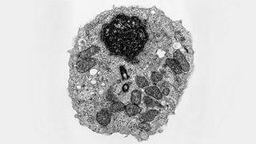
Encapsulation
This process of protecting data from the user is called encapsulation
A biological cell has a cell membrane that encapsulates the cell
All information, including mitochondria, dna and other proteins are protected inside the cell
dna is actually protected inside the nucleus: a cell within the cell
The membrane prevents anything other than what is required to enter the cell
The membrane blocks ions and larger molecules
There are transport proteins on the membrane surface that facilitate the transfer of specific molecules like glucose
https://www.bbc.co.uk/bitesize/guides/zg9mk2p/

Slide 16
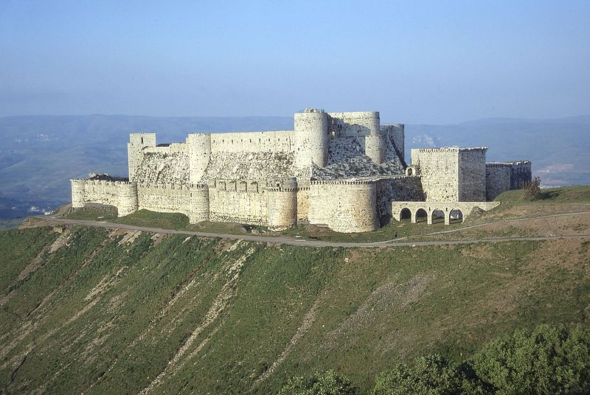
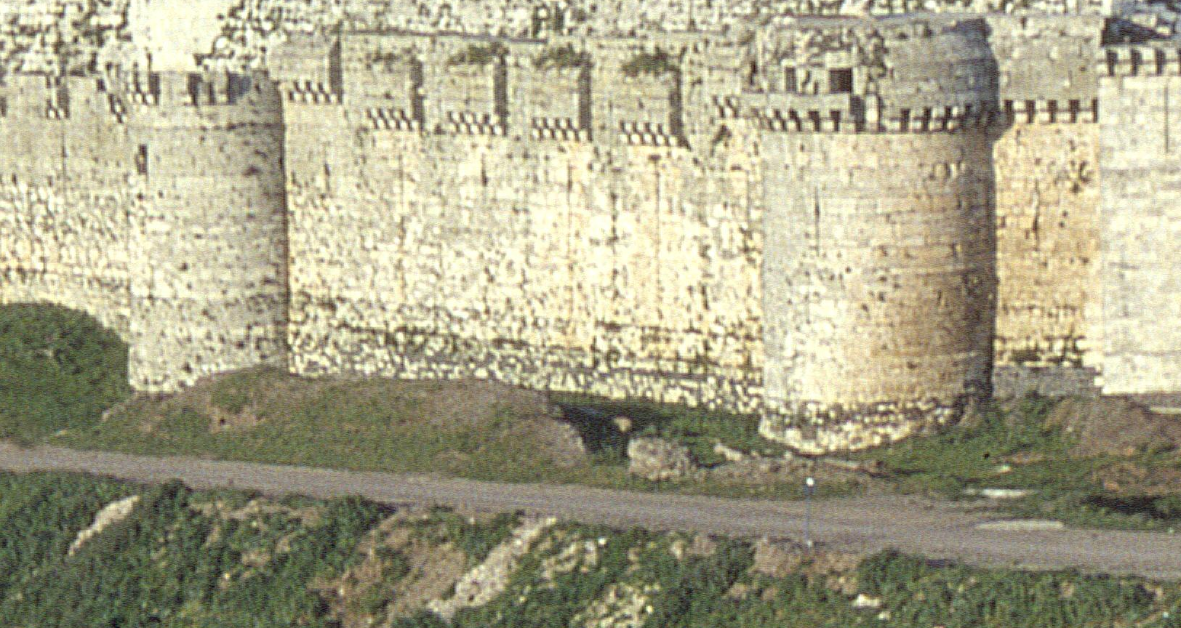
Encapsulation is not security
One word of warning:
Encapsulation in C++ is not security
Even if you use all the tools we will introduce, I can, with one line of code, break that encapsulation
Such breaking of encapsulation requires a very deliberate statement in C++ that is normally never used

Slide 17
Summary
Following this lesson, you now
Are aware of the issues with users being able to access and manipulate member variables
Understand to fix this problem, we cannot allow the user to access member variables
Know there are three aspects of an objects lifetime that we must secure for the user:
The object’s creation
The accessing and manipulation of objects by the user
The object’s destruction
Are aware that this will be performed encapsulation through
Constructors
Member functions
Destructors

Slide 18
References
[1] https://en.wikipedia.org/wiki/Encapsulation_(computer_programming)

Slide 19
Acknowledgements
Reiner Vergara De Leon for noting the original video was missing sound in some slides.

Slide 20
Colophon
These slides were prepared using the Georgia typeface. Mathematical equations use Times New Roman, and source code is presented using Consolas.
The photographs of lilacs in bloom appearing on the title slide and accenting the top of each other slide were taken at the Royal Botanical Gardens on May 27, 2018 by Douglas Wilhelm Harder. Please see
https://www.rbg.ca/
for more information.

Slide 21
Disclaimer
These slides are provided for the ece 150 Fundamentals of Programming course taught at the University of Waterloo. The material in it reflects the authors’ best judgment in light of the information available to them at the time of preparation. Any reliance on these course slides by any party for any other purpose are the responsibility of such parties. The authors accept no responsibility for damages, if any, suffered by any party as a result of decisions made or actions based on these course slides for any other purpose than that for which it was intended.

